Slide 1

PRODUCT ANALYSIS Of NON WORKING HOURS PAGE
PAVLOS KALAVASIS

Slide 2
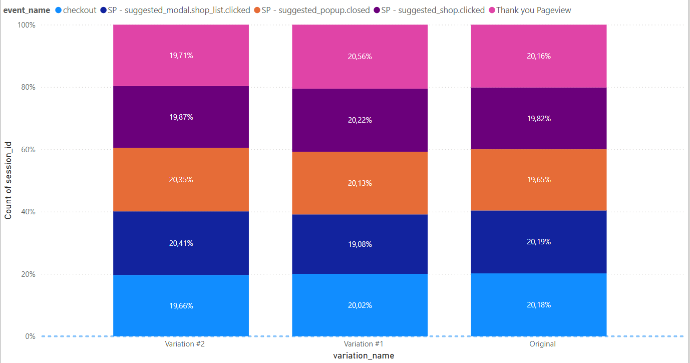
Sessions per Variations and Events

Slide 3
Sessions per Variations and Events (vacation days)
*The sample is the 5% of total sessions

Slide 4
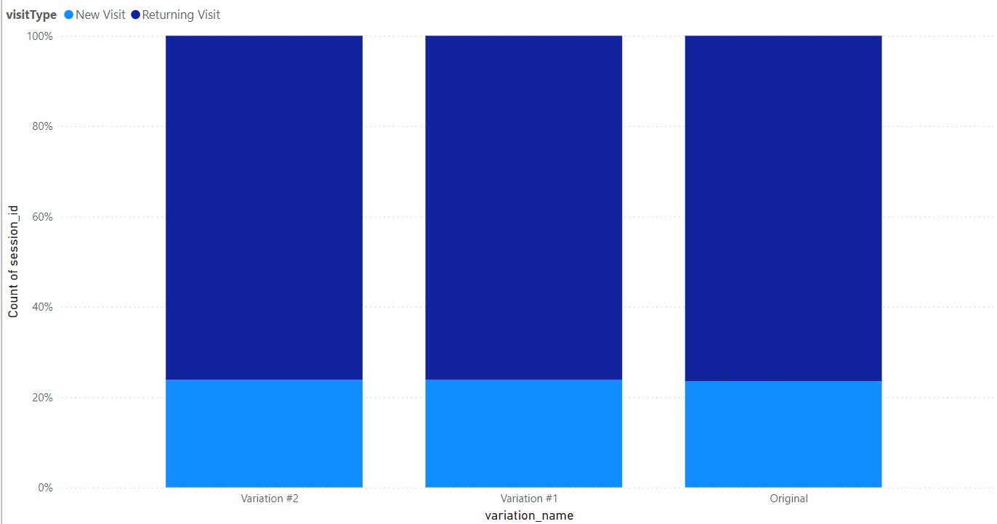
Sessions per Variations and Visit Type

Slide 5
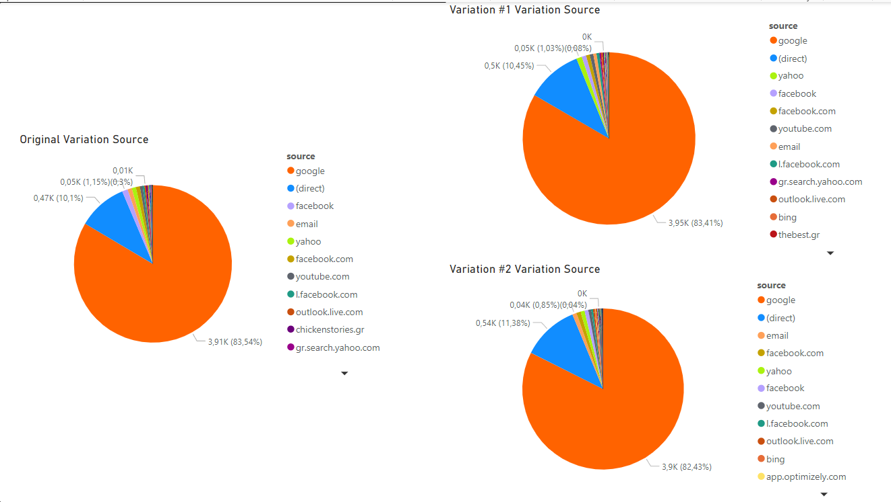
Sessions per Variations and Source

Slide 6
Sessions per Variations and Source and Medium

Slide 7
Conclusion
The best overall variation is Variation#1
Exhibits strong performance metrics
Has the highest transaction rate (40.2%) among direct visitors and solid
engagement across various sources
Emerges as the best overall option, particularly for direct traffic and new visitors
Drives higher engagement metrics, such as suggested shop clicks and checkout loaded rates, which are crucial for converting users into transactions

Slide 8

Thank you

